Slide 1
Microservices Architecture: Why It’s Used, Examples, Advantages & Disadvantages
Understanding modular design for scalable software solutions
Notes:
AI-generated content may be incorrect. ---

Slide 2
Introduction to Microservices Architecture
Notes:
Overview and Definition

Slide 3

Overview and Definition
Microservices Architecture Concept
Microservices structure applications as small, independent services focused on specific business capabilities.
Advantages Over Monolithic
Microservices enable modularity, parallel development, scalability, and flexibility unlike tightly-coupled monoliths.
Challenges of Microservices
Managing distributed systems and ensuring data consistency are key challenges in microservices architecture.
Notes:
Microservices architecture is a modern approach to software design that structures an application as a collection of small, independent services. Each service is responsible for a specific business capability and communicates with other services through lightweight protocols, typically HTTP APIs. Unlike monolithic architectures, where all components are tightly coupled and deployed as a single unit, microservices allow for modularity and independence. This means that each service can be developed, deployed, and scaled separately, enabling teams to work in parallel and adopt different technologies for different services. The architecture promotes agility, flexibility, and resilience, making it particularly suitable for large-scale, complex applications that require frequent updates and rapid innovation. By breaking down applications into smaller components, organizations can achieve better fault isolation, faster time-to-market, and improved scalability. However, this approach also introduces challenges such as increased complexity in managing distributed systems and ensuring data consistency across services.

Slide 4
Why Microservices Are Used
Notes:
Key Benefits and Motivations

Slide 5
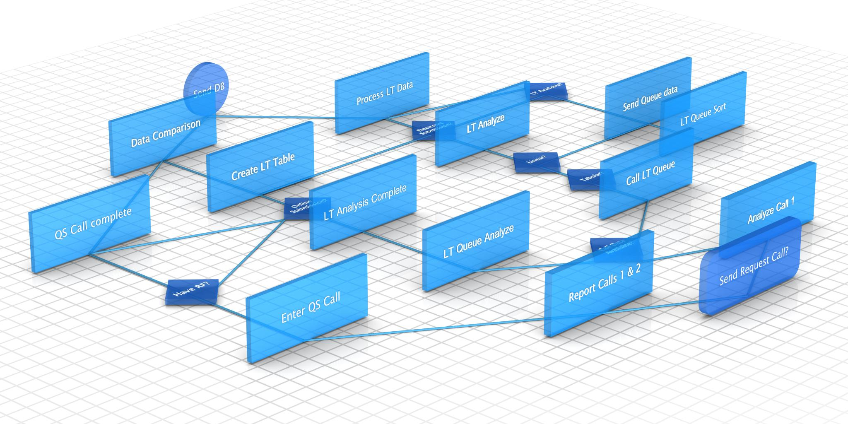
Key Benefits and Motivations
Scalability
Microservices allow independent scaling of services, optimizing resource use and reducing costs effectively.
Flexibility and Innovation
Teams can choose technologies freely per service, accelerating development and fostering innovation.
Faster Deployment
Updates to a single service enable faster deployment cycles, reducing downtime and improving responsiveness.
Enhanced Resilience
Failures in one service do not affect the whole system, increasing overall system reliability.
Notes:
Organizations adopt microservices architecture for several compelling reasons. Scalability is one of the primary drivers; individual services can be scaled independently based on demand, which optimizes resource usage and reduces costs. Flexibility is another major advantage, as teams can choose the most suitable technology stack for each service without being constrained by a single platform. This autonomy accelerates development and fosters innovation. Faster deployment cycles are also a significant benefit, as updates to one service do not require redeploying the entire application, reducing downtime and improving responsiveness to market changes. Additionally, microservices enhance resilience because failures in one service are less likely to impact the entire system, improving overall reliability. These benefits make microservices particularly attractive for businesses operating in dynamic environments where rapid adaptation and continuous delivery are critical to success.

Slide 6
Practical Examples of Microservices
Notes:
Industry Use Cases

Slide 7
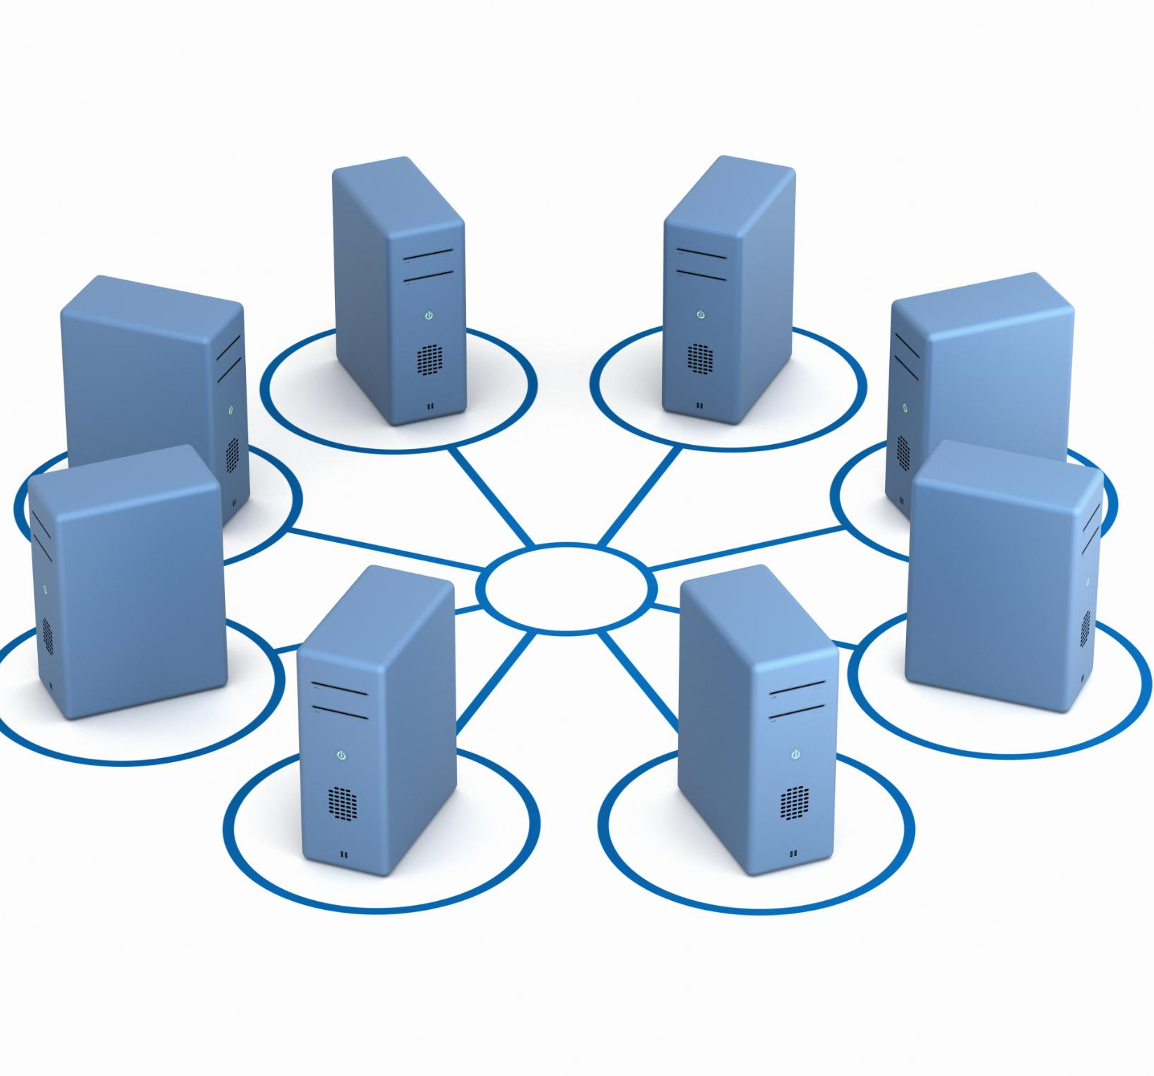
Industry Use Cases
Microservices in Streaming
Microservices enable streaming platforms to independently manage content delivery, recommendations, and billing.
E-commerce Platform Modularity
Microservices help e-commerce sites separate product catalog, payment, and shipping for rapid innovation.
Ride-Hailing System Scalability
Microservices support ride matching, payments, and notifications ensuring smooth user experiences under high demand.
Notes:
Several leading technology companies have successfully implemented microservices architecture to achieve scalability and flexibility. Netflix is a prime example, using microservices to manage streaming, recommendations, and billing systems independently. This approach allows Netflix to handle massive traffic and deliver personalized experiences efficiently. Amazon also leverages microservices for its e-commerce platform, separating services such as product catalog, payment processing, and shipping logistics. This modularity enables Amazon to innovate rapidly and maintain high availability across its global operations. Uber employs microservices to manage ride matching, payment transactions, and real-time notifications, ensuring seamless user experiences even during peak demand. These examples illustrate how microservices empower organizations to build robust, scalable systems that can evolve quickly to meet changing customer needs.

Slide 8
Advantages and Disadvantages
Notes:
Advantages of Microservices, Disadvantages of Microservices

Slide 9

Advantages of Microservices
Independent Deployment
Microservices allow updates to individual services without impacting the entire system, reducing downtime.
Technology Diversity
Teams can choose diverse tools and frameworks for each microservice, promoting innovation and efficiency.
Fault Isolation
Issues in one service do not affect others, enhancing system reliability and user experience.
Scalability and Resource Allocation
Resources can be allocated to specific services as needed, optimizing performance and costs.
Notes:
Microservices architecture offers numerous advantages that make it appealing for modern software development. Independent deployment is a key benefit, allowing teams to release updates to individual services without affecting the entire application. This reduces downtime and accelerates delivery cycles. Technology diversity is another advantage, as teams can select the best tools and frameworks for each service, fostering innovation and efficiency. Improved fault isolation ensures that issues in one service do not cascade across the system, enhancing reliability and user experience. Additionally, microservices enable better scalability by allowing organizations to allocate resources to specific services based on demand, optimizing performance and cost-effectiveness. These benefits collectively contribute to greater agility, resilience, and competitiveness in fast-paced markets.

Slide 10

Disadvantages of Microservices
Increased Complexity
Managing numerous microservices demands sophisticated orchestration, monitoring, and deployment systems to handle complexity.
Network Latency Issues
High volumes of communication between services can cause network latency, impacting overall system performance.
Data Consistency Challenges
Maintaining transactional integrity across distributed services is difficult, risking data inconsistency.
Rising Infrastructure Costs
Microservices often require more servers and advanced tools, increasing infrastructure and operational expenses.
Notes:
Despite their advantages, microservices come with challenges that organizations must address. Increased complexity is a major drawback, as managing multiple services requires sophisticated orchestration, monitoring, and deployment strategies. Network latency can become an issue due to the high volume of inter-service communication, potentially impacting performance if not optimized. Data consistency is another concern, as maintaining transactional integrity across distributed services is inherently difficult. Furthermore, infrastructure costs can rise because microservices often require more servers, containers, and advanced tooling for observability and security. These disadvantages highlight the importance of careful planning and robust DevOps practices when adopting microservices architecture.

Slide 11
When to Use Microservices
Notes:
Ideal Scenarios for Adoption

Slide 12

Ideal Scenarios for Adoption
Suitability for Complex Systems
Microservices are ideal for large, complex applications requiring frequent updates and continuous delivery.
Supports Multiple Teams
Enables parallel development by multiple teams working on different system components, reducing dependencies.
High Scalability Needs
Benefits applications demanding high scalability, such as e-commerce, streaming, and ride-sharing platforms.
Consideration for Smaller Projects
Smaller or less complex projects may find microservices overhead outweighs benefits, requiring careful assessment.
Notes:
Microservices architecture is best suited for large, complex applications that require frequent updates and continuous delivery. It is particularly beneficial for organizations with multiple development teams working on different components of a system, as it enables parallel development and reduces dependencies. Applications that demand high scalability, such as e-commerce platforms, streaming services, and ride-sharing apps, can greatly benefit from microservices. However, for smaller projects or systems with limited complexity, the overhead of managing microservices may outweigh the benefits. Therefore, organizations should carefully assess their requirements, resources, and long-term goals before deciding to implement microservices.

Slide 13
Conclusion and Q&A
Notes:
Summary and Discussion

Slide 14

Summary and Discussion
Benefits of Microservices
Microservices enhance scalability, flexibility, and resilience compared to traditional monolithic designs.
Challenges of Microservices
Organizations face complexity, latency, and cost challenges when adopting microservices architecture.
Ideal Use Cases
Microservices suit large-scale applications requiring rapid innovation and frequent updates.
Consideration for Adoption
Evaluate alignment of microservices with organizational goals and technical capabilities before adoption.
Notes:
In summary, microservices architecture represents a significant shift from traditional monolithic design, offering enhanced scalability, flexibility, and resilience. It is widely adopted by industry leaders such as Netflix, Amazon, and Uber to meet the demands of modern, dynamic markets. While the advantages are compelling, organizations must also consider the challenges, including complexity, latency, and cost. Microservices are most effective for large-scale applications that require rapid innovation and frequent updates. As we conclude, consider whether microservices align with your organization’s goals and technical capabilities. Now, let’s open the floor for questions and discussion on how microservices might fit into your projects.

